Slide 1
The Charter of Fundamental Rights – Freedom to conduct a business
Dr Jonas Grimheden
EJTN-FRA 19–20 April 2018

Slide 2
Charter of Fundamental Rights of the EU
Preamble
Peace – common values
Universal values
Diversity, etc
Rights more visible
Reaffirms const. and int’l rights
Rights, duties, responsibilities
Rights, freedoms and principles
I Dignity
(Articles 1–5)
1 Human dignity
2 Life
3 Integrity of the person
4 Torture and inhuman degrading treatment or punishment
5 Slavery and forced labour
II Freedoms
(Articles 6–19)
6 Liberty and security
7 Private and family life
8 Personal data
9 Marry and found family
10 Thought conscience and religion
11 Expression and information
12 Assembly and association
13 Arts and sciences
14 Education
15 Choose occupation and engage in work
16 Conduct a business
17 Property
18 Asylum
19 Removal, expulsion or extradition
III Equality
(Articles 20–26)
20 Equality before the law
21 Non-discrimination
22 Cultural, religious and linguistic diversity
23 Equality: men and women
24 The child
25 Elderly
26 Integration of persons with disabilities
IV Solidarity
(Articles 27–38)
27 Workers right to information and consultation
28 collective bargaining and action
29 Access to placement services
30 Unjustified dismissal
31 Fair and just working conditions
32 Prohibition of child labour and protection of young people at work
33 Family and professional life
34 Social security and assistance
35 Health care
36 Access to services of general economic interest
37 Environmental protection
38 Consumer protection
V Citizens’ rights (Articles 39–46)
39 Vote and stand as candidate to EP
40 Vote and stand as candidate at municipal elections
41 Good administration
42 Access to documents
43 European ombudsman
44 Petition (EP)
45 Movement and residence
46 Diplomatic and consular protection
VI Justice
(Articles 47–50)
47 Effective remedy and fair trial
48 Presumption of innocence and right of defence
49 Legality and proportionality of criminal offences and penalties
50 Ne bis in idem
VII General provisions (Articles 51–54)
51 Application
52 Scope and interpretation
53 Level of protection
54 Prohibition of abuse of rights

Slide 3
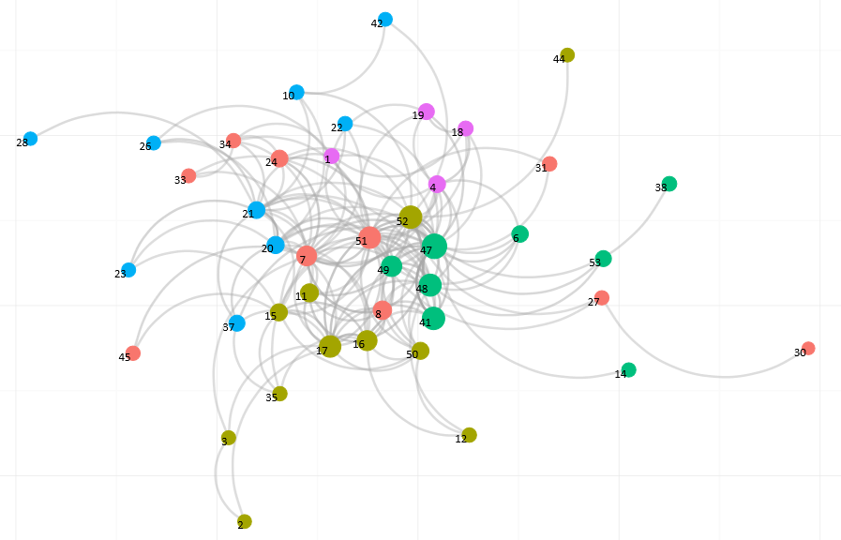

Network of Charter of Fundamental Rights articles in ECJ cases (2001-2015)

Slide 4
European Union
Constitutional traditions of the EU Member States
General principles of EU law
Unwritten
Charter of Fundamental Rights of the European Union
Written
Council of Europe standards
United Nations standards
Informs
Accession
Accession
ECHR
CRPD
Istanbul

Slide 5
Right
EU Charter provision
Council of Europe
United Nations
Dignity
1
UDHR 1; ICCPR 1; ICESCR 1
Life
2(1)
ECHR 2
UDHR 3; ICCPR 6(1)+
No death penalty
2(2)
ECHR P13 1
ICCPR 6(2-6)+
Physical/mental integrity
3(1)
Biomedical Conv. 1
ICCPR 7
Informed consent
3(2)
Biomedical Conv. 5-9
Dignity
Anti-eugenics
3(2)
Biomedical Conv. 11-14
UDHR 16
Profit from body
3(2)
Biomedical Conv. 21
Anti-cloning
3(2)
Biomedical Conv. P on cloning
Decl. on Human Cloning
Torture
4
ECHR 3
UDHR 5; ICCPR 7; CAT
Slavery
5(1)
ECHR 4(1)
UDHR 4; ICCPR 8
Forced labour
5(2)
ECHR 4(2-3)
ICCPR 8(3)
Human trafficking
5(3)
Conv. Trafficking in Human Beings
ICCPR 8(1-2)
Liberty and security
6
ECHR 5 & P4 1
UDHR 3 & 9; ICCPR 9 &10
Privacy and family
7
ECHR 8+
UDHR 12
Personal data
8
Conv. 108
Marriage and form family
9
ECHR 12
UDHR 16; ICCPR 23(2-4)
Thought and conscience
10(1)
ECHR 9
UDHR 18; ICCPR 18+
Conscientious objection
10(2)
ECHR 9
UDHR 18; ICCPR 18+
Expression
11(1)
ECHR 10+
UDHR 19; ICCPR 19+
Media
11(2)
ECHR 10+
UDHR 19; ICCPR 19+
Assembly and association
12
ECHR 11+
UDHR 20 & 23(4); ICCPR 20-22; ICESCR 8
Arts and sciences
13
Biomedical Conv. Expl. notes
ICESCR 15(2-3)
Access to education
14(1)
ECHR P1 2
UDHR 26(1)
Freedoms
Free compulsory education
14(2)
UDHR 26(1); ICESCR 13(1-2) & 14
Parents choice of education
14(3)+
ECHR P1 2+
UDHR 26(3); ICCPR 18(4); ICESCR 13(3)
Occupation (choice)
15(1)
UDHR 23(1); ICESCR 6(1)
ESC 1
Occupation (movement)
15(2)
ESC 18
ESC 18
Parity of conditions
15(3)
ESC 19
Conduct business
16
Property
17+
ECHR P1 1+
UDHR 17
Intellectual property
17(2)
UDHR 27(2)
Asylum
18
UDHR 14
Collective expulsion
19(1)
ECHR P4 4
CERD 5
Deportation with risk
19(2)
ECHR 3 (Seoering v UK)
CAT 3
The Evolution of Fundamental Rights Charters and Case Law (2011), European Parliament, Directorate-General for Internal Policies

Slide 6
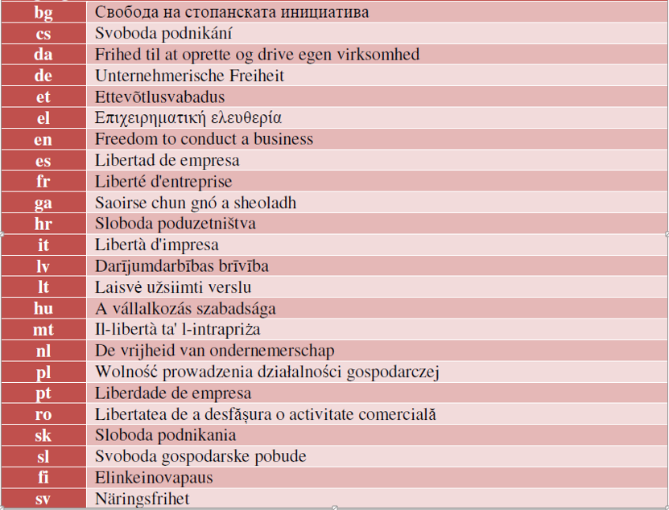
Context
A modern supplement to the right to work (Art. 15 of the Charter) and workers’ rights (Title IV)
  Greater reliance on FCB would bode well for a more inclusive growth model, with migrants, youth and women
ECHR, ICCPR - property
ICESCR Art. 6 (1); CRPD Art. 27
EU Charter of Fundamental Rights – ‘human’ right? SMEs, TNC?
Enhanced protection (beyond right of establishment, TFEU Art. 49 et seq)
  In the area of EU law – not limited to EU citizens; applicable also to companies; and not hinging on a cross-border situation

Slide 7

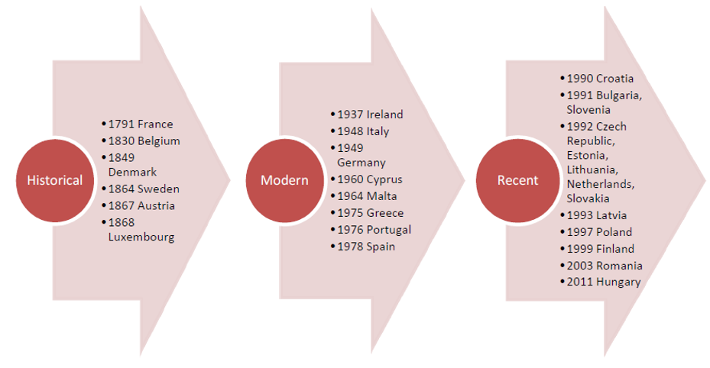
Freedom to conduct a business
Constitutional traditions

Slide 8
A case-study – Non-discrimination v Art. 16
Equal treatment
Employment
Reception services
Headscarves – dismissal of Muslim woman
In-direct discrimination or legitimate aim?
G4S Secure Solutions NV
http://curia.europa.eu/juris/document/document.jsf?text=&docid=188852&pageIndex=0&doclang=EN&mode=lst&dir=&occ=first&part=1&cid=376148

Slide 9
CJEU on the freedom to conduct a business
Case | Judgment year | Subject matter | ‘Counter balance’ | Fundamental rights v ? | Reference
BB construct | 2017 | Taxation (VAT) | Fraud prevention | Guarantor with tax debts (SK) | C-534/16
Neptune Distribution | 2015 | Approximation of laws | Public health | Sodium/salt content of mineral water; precautionary principle (FR) | C-157/14
Érsekcsanádi Mezőgazdasági | 2014 | Agriculture and Fisheries | Data protection | Avian influenza; compensation for damage; ‘within the scope of EU law’ (HU) | C-56/13
Schaible | 2013 | Agriculture and Fisheries | Obligation to keep registry | Sheep and goat-keepers; public interest – human health, animal welfare (DE-BW) | C-101/12
Sky Österreich | 2013 | Freedom of establishment | Right to property | Proportionality; exclusive broadcasting rights; high interest events | C-283/11
Deutsches Weintor | 2012 | Approximation of laws | Public health | ‘easily digestible’ (DE-RP) | C-544/10
OPINION: Google SPAIN | 2013 | Freedom of establishment | Data protection | ‘Right to be forgotten’; Art. 16 not mentioned in judgment (ES) | C‑131/12

Slide 10
Court of Justice on Art. 16 ‘since Lisbon’
33 judgments with reference in ‘grounds’
  23 with relevance given to Art. 16
  8 finds that Art. 16 is not complied with
Often together with Articles 15 and 17, as well as TFEU 49
The wording of the Article referring to EU law etc makes it more prone to wider ‘margin of appreciation’
Concessions, regulatory restrictions, etc
  Wide discretion (e.g. gaming licenses – “significant moral, religious and cultural differences”)
Rights are not absolute but if ‘the total right’ is at risk …

Slide 11
CJEU on Art. 16
Case |  | Issues | ‘right’ | ‘balanced’
Scarlet Extended | C-70/10 (BE) | Intellectual property rights; proportionality
SABAM | C-360/10 (BE) | Proportionality
DR and TV2 Danmark | C-510/10 (DK) | Compensation
Deutsches Weintor | C-544/10 (DE) | Health
Interseroh Scrap … | C-1/11 (DE) | Waste; business secrets
McDonagh v Ryanair | C-12/11 (IE) | Assistance (Eyjafjallajökull); consumer protection
Sky Österreich | C-283/11 (AT) | Public interest
Alemo-Herron … | C-426/11 (UK) | Workers’ rights
Schaible | C-101/12 (DE)
UPC Telekabel Wien | C-314/12 (AT) | Intellectual property
Sokoll-Seebacher | C-367/12 (AT) | New pharmacy establishment
Pfleger and Others | C-390/12 (AT) | Gaming machines
Pelckmans Turnhout | C-483/12 (BE) | Non-discrimination; prevented from open shop on Sundays | Outside scope of EU law
Érsekcsanádi Mezőg… | C-56/13 (HU)
Neptune Distribution | C-157/14 (FR)
Stylinart | C-282/14 (PL) |  | Outside scope of EU law
Polkomtel | C-397/14 (PL) | Ratione temporis – before Lisbon
Bayer CropScience | C-442/14 (NL) | Environmental protection | Art. 49 TFEU used instead
Pillbox 38 (WHO) | C-477/14 (UK)
Mc Fadden v Sony | C-484/14 (DE)
Rosneft | C-72/15 (UK)
Lidl | C-134/15 (DE) |  | Not relevant
G4S Secure Solutions | C-157/15 (NL) | Headscarves; when in contact with customers
AGET Iraklis | C-201/15 (EL) | Working conditions
Striani and Others | C-299/15 (BE) |  | Outside scope of EU law
Uber Belgium | C-526/15 (BE) |  | De
F. Hoffmann-La Roche | C-572/15 (EE) | Medicin | Not dealt with
Asklepios | C-680/15 + C-681/15 (DE) | Transfer of company
Puškár | C-73/16 (SK) | Taxation; Criminal procedural rights; Proportionality | Not dealt with
Polkomtel | C-277/16 (PL) | Market dominance; price setting
Global Starnet | C-322/16 (IT) | Gaming concessions
BB construct | C-534/16 (SK) | Fraud prevention; guarantor
 |  |  | 8 | 15
DE 6
BE 5
AT 4
PL 3
UK 2
…

Slide 12
Thanks, again!
Jonas.Grimheden@fra.Europa.eu

