Slide 1
The Charter of Fundamental Rights & the mission FRA
Dr Jonas Grimheden
EJTN-FRA 19–20 April 2018

Slide 2




European Union
Strategic Guidelines 2015-2019
Council of Europe
FRA 2007
Stockholm Program 2009-2014
CEPEJ 2002
From Paris to Lisbon
From London to Strasbourg
Lisbon
Unanimity ➔ QMV
EP as legislator
Legal personality
CFR
Citizens’ initiative
Collapsed pillars
President of European Council
CFSP High Representative as VP
EEAS
. . .
Nice Charter 2000 (2009)
Lisbon 2007 (2009) TEC/Rome➔TFEU
Commissioner for Human Rights 1999
Constitutional treaty *2001 +2005
§+
Nice 2001 (2003) +MSs, QMV
AC-FCNM 1997
Amsterdam
Police and judicial cooperation
Eurozone 1999
Amsterdam 1997 (1999) FSJ, CFSP
§
CPT 1989
Maastricht
JHA
Schengen 1995
Maastricht 1992 (1993) EU (TEU)
ECSR 1961
‘Merger’ 1965 (1967) EC
EAEC 1958
ECtHR 1959
Rome 1957
EEC (1958)
ECHR 1950 (1953)
Paris ECSC 1951
(-2002)
London 1949
Post WWII

Slide 3




























Decentralised 33
Medicines
EMA
Disease prevention
ECDC
Chemicals
ECHA
Living and working conditions
Eurofound
Banking Authority
EBA
Environment
EEA
Large-scale IT systems
Eu-LISA
Plant Variety
CPVO
Judicial cooperation
Eurojust
Insurance and Occupational Pensions EIOPA
Translations
CdT
GNSS (Navigation Satellite System)
GSA
Electronic comms. regulators
BEREC Office
Securities and markets
ESMA
Police
Europol
Aviation Safety
EASA
Railways
ERA
Border and Coast Guard
Frontex
Gender equality
EIGE
Single Resolution Board (Banking)
SRB
Fundamental Rights
FRA
Intellectual property
EUIPO
Food Safety
EFSA
Law enforcement training
CEPOL
Network and information safety
ENISA
Drugs and drug addiction
EMCDDA
Safety and Health at Work
EU-OSHA
Training Foundation
ETF
Energy regulators
ACER
Vocational training
Cedefop
Maritime Safety
EMSA
Fisheries control
EFCA
Asylum Support
EASO

Slide 4
33+6+3+2+8=52
https://europa.eu/european-union/about-eu/agencies_en#type_of_agencies
European Union Agencies Network (EUAN) (45)
https://euagencies.eu/
Decentralised (33)
Executive under common security and defence policy (3)
Other organ. (8)
Energy regulators
ACER
Banking Authority
EBA
GNSS (Navigation Satellite System)
GSA
Police
Europol
Translations
CdT
Innovation and technology
EIT
Electronic comms. regulators
BEREC Office
Disease prevention
ECDC
Gender equality
EIGE
Railways
ERA
Executive (6)
ECSEL Joint Undertaking (JU) (digital tech)
Defence
EDA
Plant Variety
CPVO
Vocational training
Cedefop
Insurance and Occupational Pensions EIOPA
Securities and markets
ESMA
Education, Audiovisual and Culture
Fuel Cells and Hydrogen 2 Joint Undertaking
Security Studies
EUISS
Safety and Health at Work
EU-OSHA
Chemicals
ECHA
Maritime Safety
EMSA
Training Foundation
ETF
SMEs (enterprises)
EASME
IMI 2 Joint Undertaking
IMI 2 JU
Satellite Centre
SatCen
Border and Coast Guard
Frontex
Environment
EEA
Medicines
EMA
Fundamental Rights
FRA
Research Council
ERCEA
SESAR Joint Undertaking
Large-scale IT systems
Eu-LISA
Fisheries control
EFCA
Drugs and drug addiction
EMCDDA
Intellectual property
EUIPO
Consumers, health, ag, food
Chafea
EUROATOM (2)
Shift2Rail Joint Undertaking
Asylum Support
EASO
Food Safety
EFSA
Network and information safety
ENISA
Single Resolution Board (Banking)
SRB
Research
EUROATOM Supply
ESA
Clean Sky 2 Joint Undertaking
Aviation Safety
EASA
Living and working conditions
Eurofound
Law enforcement training
CEPOL
Judicial cooperation
Eurojust
Innovation & Networks
INEA
Fusion for Enegery
F4E
BBI Joint Undertaking (Bio-based)

Slide 5
Potential EU Member States
EEA (EU28+3)
Negotiating EU candidates
EU (28)
Turkey
Montenegro
Schengen (EU22+4)
Serbia
Euro (EU19)
EU candidates
Cyprus
Austria
Germany
Luxembourg
Slovenia
Albania
FYRoMacedonia
Ireland
Belgium
Greece
Malta
Spain
Potential EU candidates
Estonia
Italy
Netherlands
Bosnia&Herzeg.
Kosovo
Finland
Latvia
Portugal
France
Lithuania
Slovakia
Euro
EEA
EFTA
Liechtenstein
Switzerland
United Kingdom
Czech Republic
Denmark
Hungary
Schengen
Poland
Sweden
Norway
Iceland
Bulgaria
Croatia
Romania
EU
JHA opt-outs
Not PESCO (5)
Not NATO (5)
FRA (28+1)
FRA ‘to be’ (3)
In parts inspired by The Economist, 11 June 2016, Interlocking interlocutors, p. 31

Slide 6
FRA and its environment
Independence guarantees
‘Paris Principles’
FRA’s bodies, networks, and staff
UN
OHCHR
ROE – OHCHR
CDRP Cttee
UNDP
UNICEF
…
CoE
ECtHR
ECSR
Commissioner
ECRI
CEPEJ
…
Nat’l Liaison Officers
28, respective MS appoints
Management Board
Planning and Monitoring, 1/MS + 1CoE + 2 COM
Information networks
Executive Board
Prepares decisions by MB, advises Director
EU
EC DGs
EP Cttees
Council (FREMP, etc)
Ombudsman
EDPS
(JHA) agencies
…
National
NHRIs
Equality bodies
Ombuds institutions
Parliaments
…
Ad hoc working parties
Selected through open calls for applications
Fundamental Rights Platform
Civil society representatives
Scientific Committee
11 independent members, scientific guidance
‘In the building’
Staff
Around 100 appointed by Director
Director
implements tasks, manages staff, represents externally
FRA bodies
FRA ‘Working methods’

Slide 7
Decentralised 33
Justice and Home Affairs (9)
Drugs and drug addiction
EMCDDA
EU-ANSA (research) (13)
Energy regulators
ACER
Food Safety
EFSA
Medicines
EMA
Judicial cooperation
Eurojust
Electronic comms. regulators
BEREC Office
Intellectual property
EUIPO
Living and working conditions
Eurofound
Police
Europol
Plant Variety
CPVO
Single Resolution Board (Banking)
SRB
Network and information safety
ENISA
Law enforcement training
CEPOL
Maritime Safety
EMSA
Training Foundation
ETF
Safety and Health at Work
EU-OSHA
Border and Coast Guard
Frontex
GNSS (Navigation Satellite System)
GSA
Translations
CdT
Disease prevention
ECDC
Asylum Support
EASO
Securities and markets
ESMA
Railways
ERA
Vocational training
Cedefop
Fundamental Rights
FRA
Insurance and Occupational Pensions EIOPA
Banking Authority
EBA
Chemicals
ECHA
Gender equality
EIGE
Aviation Safety
EASA
Fisheries control
EFCA
Environment
EEA
Large-scale IT systems
Eu-LISA

Slide 8
Structure
Director
Director’s Office
FRA Departments
Freedoms & Justice
Promotion
Equality & citizen’s rights
Corporate Services
Access to justice
Media and communications
FRANET & FR Report
Quality
Information society, data & privacy
Editing & production
Rights of the child
Planning
Finance & budget
Asylum, migration and border
Consultation and cooperation
Equality
Human resources
Statistics & Surveys
Awareness raising
Roma & migrant integration
Legal & contracting
FRF & HL events
ICT & Facilities

Slide 9
Objective, tasks and scope
Objective (A2)
provide EU institutions and MSs (when implementing Union law) with assistance and expertise
(a) collect, record, analyse and disseminate information and data
(b) develop methods and standards for data collection
Tasks
The conclusions, opinions and reports may concern proposals from the Commission or positions by the institutions only where a request by the respective institution has been made
They shall not deal with the legality of acts (annulment of EU acts) or with the question of whether a MS has failed to fulfil an obligation under the Treaty (infringement procedure) .
(c) carry out or encourage studies
either on its own initiative or at the request of EP, Council or Commission
(d) conclusions and opinions
Tasks (A4)
(e) annual report on FR areas
(f) thematic reports
(g) annual report on FRA activities
(h) dialogue with CSO and public awareness
Scope (A3)
1. The Agency carries out its tasks within the competencies of the Union (EU Treaties)
2. In carrying out its tasks the Agency shall refer to FR as defined in Art. 6(2) TEU
3. The Agency shall deal with FR issues in the EU and in its MSs (when implementing Union law)
Notes:
1.
Art. 3 (1) Found Reg: The Agency shall carry out its tasks “within the competencies of the Community as laid down in the Treaty establishing the European Community”.
The Treaty of Lisbon says in its Art. 1 regarding references to the Community: “Union shall replace and succeed the European Community”.
No “freezing” but dynamic reference.
2.
Art 3 (2) Found Reg: “shall refer in carrying out its tasks to fundamental rights as defined in Article 6(2) of the Treaty on European Union.”
Pre-Lisbon Art 6 (2) TEU: “The Union shall respect fundamental rights, as guaranteed by the […ECHR…] and as they result from the constitutional traditions common to the Member States, as general principles of Community law.”
Again: dynamic reference.
Therefore: the regulation is not Charter-blind.
3.
Ref to CJEU

Slide 10
IIIrd MAF
a) Victims of crime and access to justice
b) Equality and discrimination (as listed in Charter Art. 21)
c) Information society, private life and personal data
EU Treaties, including Charter of Fundamental Rights of the European Union
d) Judicial cooperation, except in criminal matters
Council Reg. 168/2007 15 Feb 2007 (FRA)
e) Migration, borders, asylum and integration
MAF: Multi-annual Framework (2018–2022)
8 Thematic Areas
f) Racism, xenophobia & related intolerance
g) Rights of the child
h) Integration and social inclusion of Roma

Slide 11
FRA’s 2018–2022 Strategy
independent centre of reference and excellence for the promotion and protection of human rights for everyone in the EU
Identifying trends – comparative data and evidence
Contributing to better law making and implementation - providing independent advice
Supporting rights-compliant policy responses – providing real-time assistance and expertise
Effectively promoting rights, values and freedoms
Strengthening cooperation with national and local fundamental rights actors – working with communities of support

Slide 12

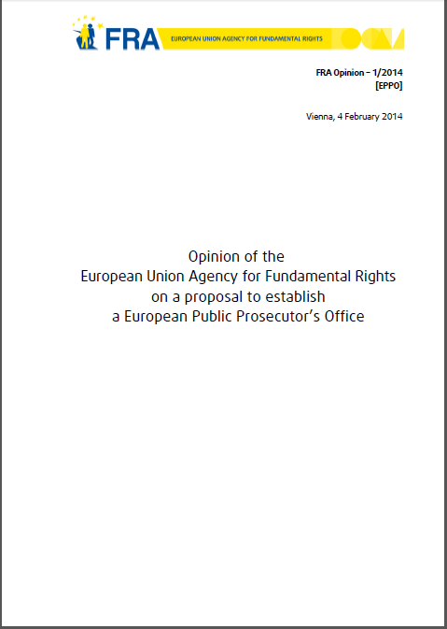


Activities
Research: Comparative studies (including surveys)
Policy cycle input: legal opinions and inputs into resolutions, conclusions, UPR, and informally to EC etc
Implementation: Dos and don’ts, victim support, ScheVal, NHRI-advice; body scanners; thematic situation reports (Ponticelli, Greek/Turkish border, HU/EL); HBs; …
Notes:
Dear Jonas,
This is what I had put in the EUI article under added values:
the backdrop of the overall fundamental rights landscape of the EU, is that the FRA adds value to the fundamental rights landscape in Europe by providing a variety of innovative elements, including21:
• socio-legal research covering all EU Member States thus providing comparable information and analysis across the EU22;
• focus on rights holders (individuals) as opposed to duty bearers (states), thus providing information also on the situation on the ground (rather than the law in the books)23;
• outreach to civil society, including through its Fundamental Rights Platform that brings together over 350 NGOs through annual meetings and online consultations;
• role as an independent expert body within the EU, including through its legal opinions on draft EU legislation (see the examples in section 4);
• a ‘joined-up governance approach’ to the protection of fundamental rights in the EU, also taking full account of the contribution of local and regional actors as well as the United Nations and the Council of Europe24 and developing networks with equality bodies, National Human Rights Institutions or Ombudspersons.

Slide 13
Topic (date) | Year (number) | Requested by
 |  | EC | EP | Council
Regulation on the European Travel Information System (ETIAS) | 2017 (2)
Business and human rights (April 2017)
Revised EURODAC (Dec 2016) | 2016 (6)
Situation in the hotspots (Nov 2016)
Children rights and revised Dublin (Nov 2016)
CRPD monitoring in the EU (May 2016)
Article 2 TEU values (April 2016)
EU Common list of safe countries of origin (March 2016)
European Criminal Record Information System (Dec 2015) | 2015 (1)
European Public Prosecutor Office (Feb 2014) | 2014 (1)
Framework Decision on Racism and Xenophobia (Oct 2013) | 2013 (2)
Equality directives (Oct 2013)
Confiscation of proceeds of crime (Dec 2012) | 2012 (3)
Data protection reform package (Oct 2012)
Property consequences of registered partnerships (Jun 2012)
Passenger Names Record II (Jun 2011) | 2011 (2)
European Investigation Order (Feb 2011)
Passenger Names Record I (Oct 2008) | 2008 (1)
Total | 18 | 2 | 13 | 3
Asylum law (4)
Criminal law (7)

Slide 14
European Union
Constitutional traditions of the EU Member States
General principles of EU law
Unwritten
Charter of Fundamental Rights of the European Union
Written
Council of Europe standards
United Nations standards
Informs
Accession
Accession
ECHR
CRPD
Istanbul

Slide 15
Charter of Fundamental Rights of the EU
Preamble
Peace – common values
Universal values
Diversity, etc
Rights more visible
Reaffirms const. and int’l rights
Rights, duties, responsibilities
Rights, freedoms and principles
I Dignity
(Articles 1–5)
1 Human dignity
2 Life
3 Integrity of the person
4 Torture and inhuman degrading treatment or punishment
5 Slavery and forced labour
II Freedoms
(Articles 6–19)
6 Liberty and security
7 Private and family life
8 Personal data
9 Marry and found family
10 Thought conscience and religion
11 Expression and information
12 Assembly and association
13 Arts and sciences
14 Education
15 Choose occupation and engage in work
16 Conduct a business
17 Property
18 Asylum
19 Removal, expulsion or extradition
III Equality
(Articles 20–26)
20 Equality before the law
21 Non-discrimination
22 Cultural, religious and linguistic diversity
23 Equality: men and women
24 The child
25 Elderly
26 Integration of persons with disabilities
IV Solidarity
(Articles 27–38)
27 Workers right to information and consultation
28 collective bargaining and action
29 Access to placement services
30 Unjustified dismissal
31 Fair and just working conditions
32 Prohibition of child labour and protection of young people at work
33 Family and professional life
34 Social security and assistance
35 Health care
36 Access to services of general economic interest
37 Environmental protection
38 Consumer protection
V Citizens’ rights (Articles 39–46)
39 Vote and stand as candidate to EP
40 Vote and stand as candidate at municipal elections
41 Good administration
42 Access to documents
43 European ombudsman
44 Petition (EP)
45 Movement and residence
46 Diplomatic and consular protection
VI Justice
(Articles 47–50)
47 Effective remedy and fair trial
48 Presumption of innocence and right of defence
49 Legality and proportionality of criminal offences and penalties
50 Ne bis in idem
VII General provisions (Articles 51–54)
51 Application
52 Scope and interpretation
53 Level of protection
54 Prohibition of abuse of rights

Slide 16
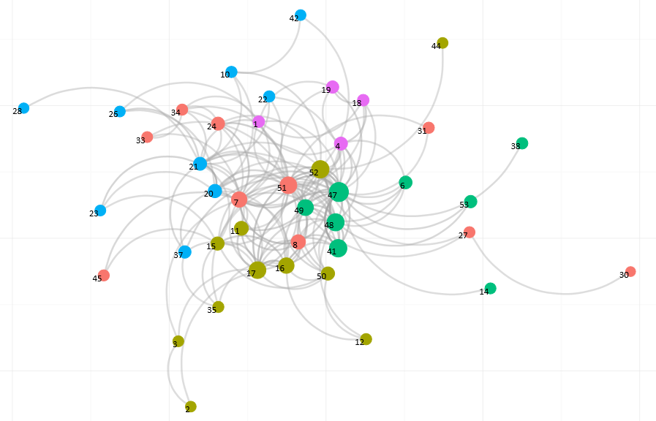
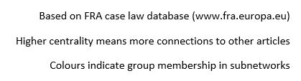
Network of Charter of Fundamental Rights articles in ECJ cases (2001-2015)

Slide 17
Fundamental rights versus human rights
International human rights law
International human rights law
International
Fundamental rights
EU
Fundamental rights
/ National (regional) constitutional rights
National
Regional
Local

Slide 18
Economic, social and cultural rights
Civil and political rights
UDHR
Universal Declaration of Human Rights
ICCPR
International Covenant on Civil and Political rights
‘Universal bill of rights’
Human rights
ICESCR
International Covenant on Economic, Social and Cultural rights
ESC
European Social Charter (Council of Europe)
ECHR
European Convention on Human Rights (Council of Europe)
CFR
Charter of Fundamental Rights of the European Union
Notes:
Jonas

Slide 19
Right
EU Charter provision
Council of Europe
United Nations
Dignity
1
UDHR 1; ICCPR 1; ICESCR 1
Life
2(1)
ECHR 2
UDHR 3; ICCPR 6(1)+
No death penalty
2(2)
ECHR P13 1
ICCPR 6(2-6)+
Physical/mental integrity
3(1)
Biomedical Conv. 1
ICCPR 7
Informed consent
3(2)
Biomedical Conv. 5-9
Dignity
Anti-eugenics
3(2)
Biomedical Conv. 11-14
UDHR 16
Profit from body
3(2)
Biomedical Conv. 21
Anti-cloning
3(2)
Biomedical Conv. P on cloning
Decl. on Human Cloning
Torture
4
ECHR 3
UDHR 5; ICCPR 7; CAT
Slavery
5(1)
ECHR 4(1)
UDHR 4; ICCPR 8
Forced labour
5(2)
ECHR 4(2-3)
ICCPR 8(3)
Human trafficking
5(3)
Conv. Trafficking in Human Beings
ICCPR 8(1-2)
Liberty and security
6
ECHR 5 & P4 1
UDHR 3 & 9; ICCPR 9 &10
Privacy and family
7
ECHR 8+
UDHR 12
Personal data
8
Conv. 108
Marriage and form family
9
ECHR 12
UDHR 16; ICCPR 23(2-4)
Thought and conscience
10(1)
ECHR 9
UDHR 18; ICCPR 18+
Conscientious objection
10(2)
ECHR 9
UDHR 18; ICCPR 18+
Expression
11(1)
ECHR 10+
UDHR 19; ICCPR 19+
Media
11(2)
ECHR 10+
UDHR 19; ICCPR 19+
Assembly and association
12
ECHR 11+
UDHR 20 & 23(4); ICCPR 20-22; ICESCR 8
Arts and sciences
13
Biomedical Conv. Expl. notes
ICESCR 15(2-3)
Access to education
14(1)
ECHR P1 2
UDHR 26(1)
Freedoms
Free compulsory education
14(2)
UDHR 26(1); ICESCR 13(1-2) & 14
Parents choice of education
14(3)+
ECHR P1 2+
UDHR 26(3); ICCPR 18(4); ICESCR 13(3)
Occupation (choice)
15(1)
UDHR 23(1); ICESCR 6(1)
ESC 1
Occupation (movement)
15(2)
ESC 18
ESC 18
Parity of conditions
15(3)
ESC 19
Conduct business
16
Property
17+
ECHR P1 1+
UDHR 17
Intellectual property
17(2)
UDHR 27(2)
Asylum
18
UDHR 14
Collective expulsion
19(1)
ECHR P4 4
CERD 5
Deportation with risk
19(2)
ECHR 3 (Seoering v UK)
CAT 3
The Evolution of Fundamental Rights Charters and Case Law (2011), European Parliament, Directorate-General for Internal Policies

Slide 20
Right
EU Charter provision
Council of Europe
United Nations
Equality before the law
20
ECHR 6 with 14
UDHR 6 & 7; ICCPR 14(1)+16
Non-discrimination
21
ECHR14; ECHR P12
UDHR 2; ICCPR 26
Respect for diversity
22
ICCPR 27
Equality
Sexual equality in work
23
ESC P 1
UDHR 23; ICCPR 3; CEDAW
Protecting children
24
ESC 7
UDHR 24(2); ICCPR 24
Independence of elderly
25
ESC P 4
UDHR 25
Disability integration
26
ESC 15
CRPD
Workers’ consultation
27
ESC P 2-3
ILO
Collective bargaining
28
ILO C87 & C98
ESC 6
Placement services
29
ESC(old) 9
Against unjust dismissal
30
Fair working conditions
31(1)
ESC(old) 3-4; ESC 2-4
UDHR 23; ICESCR 7
Maximum working hours
31(2)
ESC 2
ICESCR 7(d)
Against child labour
32
ESC 7
ICESCR 7(d)
Solidarity
Family life (legal/economic/social )
33(1)
ESC 16 & 17
UDHR 23(3); ICCPR 23(1); ICESCR 10
Maternity and paternity
33(2)
ESC 8
ICESCR 10(2)
Social security
34
ESC 12 & 13(1-4) and 14
UDHR 22 & 23(3); ICESCR 9
Housing benefits
34(3)
ESC 16 & 31
ICESCR 11
Health care (including preventive)
35
ESC 11; Biomedical Conv. 3
UDHR 24; ICESCR 12
Economic services
36
Environmental protection
37
ICESCR 12(b)
Consumer protection
38
The Evolution of Fundamental Rights Charters and Case Law (2011), European Parliament, Directorate-General for Internal Policies

Slide 21

















 | Goals | EU Charter Article | Examples of FRA projects and deliverables
 | Poverty | Art. 34 – Social security and social assistance | EU MIDIS – large scale survey of immigrants and minorities, e.g. related to Muslims Roma – local engagement as well as housing conditions | 1
 | Hunger |  | EU MIDIS – large scale survey of immigrants and minorities, e.g. related to Roma, e.g. regarding ‘going to bed hungry’ | 2
 | Health and well-being | Art. 35 – Health care | Cost of Exclusion from healthcare – migrants in an irregular situation Multiple discrimination in healthcare | 3
 | Education | Art. 14 – Right to education | Current migrant situation in the EU: Education Together in the EU – Promoting the participation of migrants and their descendants | 4
 | Gender equality | Art. 23 – Equality between women and men | Violence against women – large scale survey Discrimination against and living conditions of Roma women | 5
 | Water and sanitation | Art. 37 Environmental protection | EU MIDIS – large scale survey of immigrants and minorities, e.g. related to Roma, e.g. regarding living in housing with tap water and deprivation of basic sanitation | 6
 | Energy | Art. 36 – Access to services of general economic interest | EU MIDIS – large scale survey of immigrants and minorities, e.g. related to Roma, e.g. regarding housing with electricity | 7
 | Work and economic growth | Art. 15 – Freedom to choose an occupation and right to engage in work (+ Arts. 27–32) | EU MIDIS – large scale survey of immigrants and minorities, e.g. related to Roma, e.g. regarding discrimination in employment | 8
 | Industry, innovation and infrastructure | Art. 16 – Freedom to conduct a business | Freedom to conduct a business – a right in the EU Charter of Fundamental Rights FRA Opinion – access to remedy in the area of business and human rights | 9
 | Reduced inequalities | Art. 21 – Non-discrimination | Violence against children with disabilities Discrimination of lesbian, gay, bisexual, transgender and intersex (LGBTI) persons | 10
 | Sustainable cities and communities | Art. 37 – Environmental protection | Joined-up governance toolkit Roma – local engagement | 11
 | Responsible consumption and production | Art. 38 – Consumer protection | FRA Opinion – access to remedy in the area of business and human rights with close links to consumer protection | 12
 | Climate action | Art. 37 – Environmental protection | FRA Opinion – access to remedy in the area of business and human rights with links to access to justice in environmental cases | 13
 | Life below water |  |  | 14
 | Life on land |  |  | 15
 | Peace, justice and strong institutions | Art. 47 – Right to an effective remedy and to a fair trial (+ Arts. 48–50) | Handbook on European law related to access to justice Justice for hate crime victims | 16
 | Partnerships for the goals | Not applicable | Contributions to the work of the European Union as well as the United Nations on the SDGs | 17

Slide 22
Thanks!
Jonas.Grimheden@fra.Europa.eu

