Slide 1
The Charter of Fundamental Rights: its (scope of) application
EJTN training workshop
Vienna, FRA, 19 April 2018
Gabriel N. Toggenburg (FRA)

Slide 2
What this part covers
Section I
Introduction: What is meant by the “scope of the Charter”?
Section II
The Charter’s added value
Section III
The use of the Charter before national courts
Section III
Digging deeper: When does national law fall “within the scope of EU law”?

Slide 3
Different aspects of the Charter’s ‘scope’
Rights covered: very modern, encompassing, innovative
Rights holders addressed: individuals and private legal persons (eventually even public entities)
Situations covered: limited to those governed by EU law

Slide 4
Other aspects: the 7 ‘rules’ of Article 52
1. General limitations to Charter rights: Article 52 (1)
  Provided for by law; respect essence; proportional
2. Relationship with Treaties: Article 52 (2)
    right listed also in the Treaties shall be exercised under the conditions and within the limits defined by those.
3. Relationship with ECHR: Article 52 (3)
    ECHR as a minimum standard
    Absolute rights (title I rights plus others)

Slide 5
Other aspects: 7 rules of Article 52
4. Relationship with national law: Article 52 (4)
    Charter as a minimum standard
    BUT: Case C-399/11 Stefano Melloni (2013) limits space for protection beyond the Charter
5. Limited reach of principles: Article 52 (5)
    may be implemented by legislative and executive acts …. They shall be judicially cognisable only in the interpretation of such acts and in the ruling on their legality
  6. national laws and practices: Article 52 (6)
      Full account shall be taken of those specified in the Charter

Slide 6
Other aspects: 7 rules of Article 52
7. Explanations: Article 52 (7)
    Due regard to be given by the courts of the Union and of the Member States

Slide 7
Article 51: The Charter’s “field of application”
“1. … Charter … addressed to the Member States only when they are implementing Union law. They shall therefore respect the rights, observe the principles and promote the application thereof in accordance with their respective powers and respecting the limits of the powers of the Union as conferred on it in the Treaties.
2. The Charter does not extend the field of application of Union law beyond the powers of the Union or establish any new power or task for the Union, or modify powers and tasks as defined in the Treaties.“

Slide 8
Why to oblige MS under the Charter?
“It is also important to consider the objective of protecting fundamental rights in EU law, which is to ensure that those rights are not infringed in areas of EU activity, whether through action at EU level or through the implementation of EU law by the Member States.”
CJEU 6 March 2014, Siragusa, Case C-206/13, para. 31.
“Situations cannot exist which are covered in that way by European Union law without those fundamental rights being applicable. The applicability of European Union law entails applicability of the fundamental rights guaranteed by the Charter.”
CJEU 26 February 2013, Åkerberg Fransson, Case C‑617/10, para. 21.

Slide 9
The ‘mystery‘ of the scope: ECHR vs.CFREU
All State actions and omissions
ECHR:
all State action/omission
fully covered
Foggy borderline
EU human rights obligations: coverage by limited to cases where and when the Member State is “implementing EU law” in the sense of Article 51 of the Charter and the CJEU’s case law (“acting within the scope of EU law”, “in respect of matters covered by EU law” etc)

Slide 10
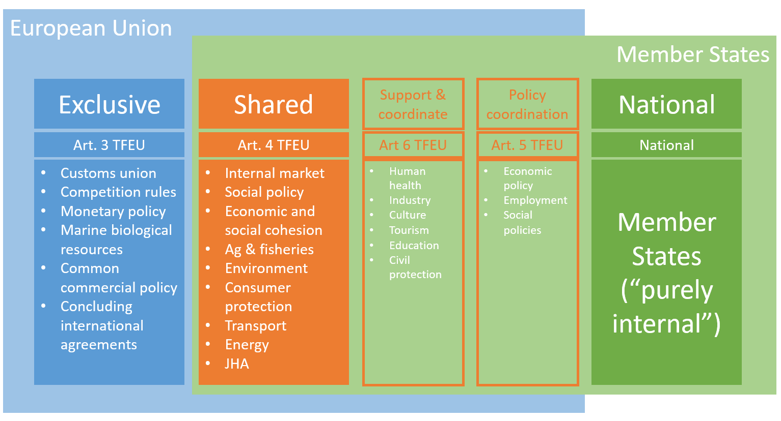
States act autonomously:‘Charter-free zones‘

Slide 11
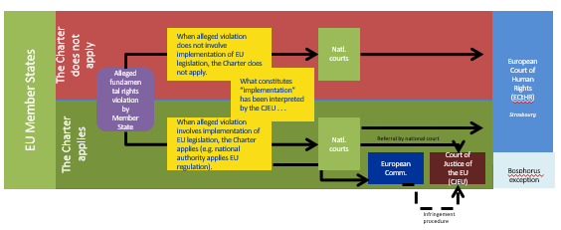
Limited scope affects access to justice

Slide 12
Does the Charter add value?
In terms of Member State behaviour covered?
No
In terms of rights covered?
Yes
In terms of procedural protection offered?
Yes

Slide 13
Added value: Charter and ECHR
“In so far as this Charter contains rights which correspond to rights guaranteed by the [ECHR] the meaning and scope of those rights shall be the same as those laid down by the said Convention. This provision shall not prevent Union law providing more extensive protection.” (Art. 52 Para 3)

Slide 14
The Charter’s innovative potential
Notes:
Title I:
integrity of the person
II:
freedom to conduct a business
Asylum
Choose occupation and engage in work
III:
Diversity
Children
Elderly
Integration of persons with disability

Slide 15
Equivalent protection to ECHR
No ECHR equivalent
More extensive than ECHR
EU context-specific
Preamble
Peace – common values
Universal values
Diversity, etc
Rights more visible
Reaffirms const. and int’l rights
Rights, duties, responsibilities
Rights, freedoms and principles
I Dignity
(Articles 1–5)
1 Human dignity
2 Life
3 Integrity of the person
4 Torture and inhuman degrading treatment or punishment
5 Slavery and forced labour
II Freedoms
(Articles 6–19)
6 Liberty and security
7 Private and family life
8 Personal data
9 Marry and found family
10 Thought conscience and religion
11 Expression and information
12 Assembly and association
13 Arts and sciences
14 Education
15 Choose occupation and engage in work
16 Conduct a business
17 Property
18 Asylum
19 Removal, expulsion or extradition
III Equality
(Articles 20–26)
20 Equality before the law
21 Non-discrimination
22 Cultural, religious and linguistic diversity
23 Equality: men and women
24 The child
25 Elderly
26 Integration of persons with disabilities
IV Solidarity
(Articles 27–38)
27 Workers right to information and consultation
28 collective bargaining and action
29 Access to placement services
30 Unjustified dismissal
31 Fair and just working conditions
32 Prohibition of child labour and protection of young people at work
33 Family and professional life
34 Social security and assistance
35 Health care
36 Access to services of general economic interest
37 Environmental protection
38 Consumer protection
Source of categories: NL HB
V Citizens’ rights (Articles 39–46)
39 Vote and stand as candidate to EP
40 Vote and stand as candidate at municipal elections
41 Good administration
42 Access to documents
43 European ombudsman
44 Petition (EP)
45 Movement and residence
46 Diplomatic and consular protection
VI Justice
(Articles 47–50)
47 Effective remedy and fair trial
48 Presumption of innocence and right of defence
49 Legality and proportionality of criminal offences and penalties
50 Ne bis in idem
VII General provisions (Articles 51–54)
51 Application
52 Scope and interpretation
53 Level of protection
54 Prohibition of abuse of rights

Slide 16
The Charter’s potential to offer more in terms of substantial rights
The Charter also provides rights that are not included in (all) national constitutions as e.g.
  explicit asylum rights (Articles 18 and 19);
  rights of the child (Article 24)
  right to good administration (Article 41)
  the freedom to conduct a business (Article 16)

Slide 17
The Charter’s potential to ‘offer more’ in terms of procedural aspects/effects
Supremacy and direct effect can play a role when interpreting national law; interpreting EU law; checking national law against the Charter; checking EU legislation against the Charter
National courts and authorities are under a duty to apply EU law and set aside conflicting norms of national law (example of Benkharbouche case, 2017)

Slide 18
The Charter’s use at national level
Relatively low quantity of references to the Charter before national courts with most references being superficial
Low quantity of references to the Charter during the legislative process at national level with most references being superficial
Hardly any government policies in place to promote the Charter
Scope of the Charter as a stumbling bloc?

Slide 19
National courts: the Charter’s combined use
Number of references to other legal sources alongside the Charter in analysed court decisions, by legal source referred to (71 decisions analysed for 2017)

Slide 20
National courts: relevant policy areas
Number of analysed court decisions, by policy area analysed for 2017

Slide 21
National courts: relevant Charter rights
Number of references to respective Charter rights in the 71 decisions analysed for 2017

Slide 22
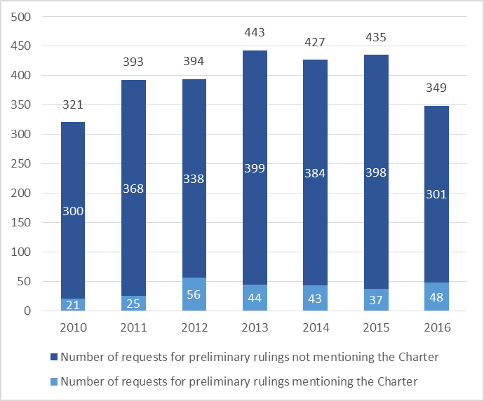
Charter and requests for prelim. rulings (RPRs)

Slide 23
Most relevant Charter rights in RPRs

Slide 24
What does “implementing EU law mean”?
the same as ‘acting within the scope of EU law’ and covers a wide range of situations
minimum requirement: there must be some connection with Union law (other than the Charter)
this connection is sufficiently concrete if Member States act as agents for the EU or in situations in which they need to rely on some kind of authorization of EU law

Slide 25
National acts meant to transpose EU law
Covers all kind of legislative or regulatory measures
All levels of national measures qualify as implementation
Also, national measures using the margin of appreciation granted by EU law (directives) qualify as “implementing Union law” in the sense of Art. 51: in exercising the discretion granted by the EU legislator, MS have to respect the Charter

Slide 26
Pre-existing national legislation
Where pre-existing national provisions can ensure that EU law is implemented there is no need for new legislation transposing e.g. an EU directive
Such national provisions qualify as ‘implementing Union law’
Once such norms change form purely internal measures to measures implementing EU law, they have to conform with the Charter

Slide 27
Measures not intended to implement EU law
Measures that are not designed to implement EU law but fall within the scope of EU law (Case C-555/07, Kuecuedeveci)
This is basically about scenarios where a Member States is not properly implementing EU legislation
Note: a mere interaction is not sufficient to bring national legislation within the scope of EU law (Case C-206/13, Siragusa or C-198/13 Julian Hernandez)

Slide 28
Concepts of national law referred to in EU law
National concepts/terms can imply ‘implementation’ in the sense of Article 51 if used in the context of the EU provisions at issue (see e.g. CJEU, Rodriguez Caballero, Case C-442/00)

Slide 29
Concepts of national law referred to in EU law
An EU directive relating to the protection of employees in the event of the insolvency states that the directive is without prejudice to national law as regards the definition of the terms such as employee, employer and pay. The directive thus refers to national law; it is for national law to specify these terms and to define them.
If these national legal concepts are used in context of that directive, the EU fundamental rights apply, regardless whether it concerns new national legislation specifically made to transpose the directive or whether they are existing national legal concepts (e.g. by virtue of employment law).

Slide 30
National law using discretionary powers granted by the EU
Qualifies as ‘implementing EU law’, regardless of whether it concerns mandatory or optional exercise of discretionary powers (CJEU, Sabou, Case C-276/12 or Milkova, Case C-406/15)
This does not apply if EU law simply recognises existing MS powers to take more favourable provisions (gold plating). Gold plating falls in the scope of EU law if the EU law act makes this explicit: see Art 4(1) AMSD

Slide 31
National provision concerning remedies, sanctioning and enforcement
If such provisions are used to guarantee the application of EU law they qualify as implementation in the sense of Art. 51
This applies also if EU law does not establish a respective obligation (as in Art 9 Dir 2000/78). See Art. 4 (3) TEU and respective case law
Such acts qualify as implementation irrespective of whether they are adopted in order to transpose EU law (e.g. Case C-218/15, Paoletti; Case C-405/10, Garenfeld)

Slide 32
National measures falling under a prohibition and needing EU law authorisation
Where Member States risk to discriminate based on nationality, to restrict fundamental freedoms or deprive Union citizens of the genuine enjoyment of their citizens rights they may invoke exceptions: but then they have to respect EU fundamental rights
Case C-98/14, Berlington; Case C-368/95, Familiapress; Case C-165//14, Rendon Marin

Slide 33
Voluntary references in national law to (concepts of) EU law
Per se such references do not bring national law within the scope of EU law (Case C-482/10, Teresa Cicala)
However CJEU might have jurisdiction to interpret these terms (and hence the Charter may play a role) if the national law makes them applicable directly and unconditionally in order to ensure that internal situations and situations governed by EU law are treated in same way

Slide 34
National measures falls in an area in which the EU has legislative powers
Not sufficient to trigger application of Charter
Two additional criteria need to be fulfilled:
  the EU has exercised these powers
  the national measure falls in the exact scope of application of these legislative measures

Slide 35
Criteria to determine field of application
24 “requires a certain degree of connection above and beyond the matters covered being closely related or one of those matters having an indirect impact on the other”.
25 ”…some of the points to be determined are whether that legislation is intended to implement a provision of EU law; the nature of that legislation and whether it pursues objectives other than those covered by EU law, even if it is capable of indirectly affecting EU law; and also whether there are specific rules of EU law on the matter or capable of affecting it …”.
CJEU, Case C-206/13, Cruciano Siragusa

Slide 36
Criteria to determine field of application
26 ”In particular, the Court has found that fundamental EU rights could not be applied in relation to national legislation because the provisions of EU law in the subject area concerned did not impose any obligation on Member States with regard to the situation at issue in the main proceedings”
CJEU, Case C-206/13, Cruciano Siragusa

Slide 37
Within and beyond the Charter’s scope
STATE AS EU AGENT
EU AUTHORISATION
SCOPE
Charter NOT applicable
New legislation formally transposing
Exceptions granted by EU primary law
Legislation falling within scope of EU legislation
Legislation outside the scope of EU law
Old legislation substantially transposing
National legislation voluntarily using EU law concepts
Discretion granted by EU secondary law
“Goldplating”
Remedies, sanctions, enforcement
National legislation using national legal concepts referred to by EU legislation

Slide 38
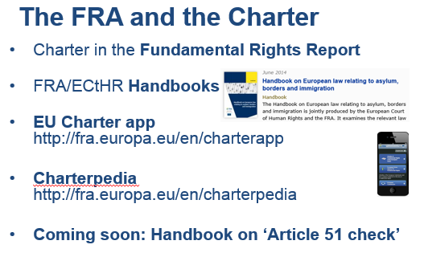
The END – Many thanks for your patience!

