Slide 1

Themis Competition 2012
Why are we against the application of the principle of mutual recognition to evidence issues ?
Team France 6
Milène Chebrout
Stéphanie De Porti
Léopoldine Fay

Slide 2
What evidence are we talking about?

Slide 3
What evidence are we talking about?
Evidence which already exists ?

Slide 4
What evidence are we talking about?
Evidence which already exists ?
The gathering of evidence ?

Slide 5
Main issues :
Harmonization is insufficient to fully respect the fundamental principles of criminal procedure

Slide 6
Main issues :
Harmonization is insufficient to fully respect the fundamental principles of criminal procedure
The consequences of the automatic application of the principle of mutual recognition on the rights and liberties of the defendant

Slide 7
Part 1:
The so problematic application of the principle of mutual recognition to evidence issues regarding the different legal orders of the Member States

Slide 8
Part 1: The so problematic application of the principle of mutual recognition to evidence issues regarding the different legal orders of the Member States
Conceptual problem

Slide 9
Part 1: The so problematic application of the principle of mutual recognition to evidence issues regarding the different legal orders of the Member States
Conceptual problem
- In relation to the definition of the principle of mutual recognition

Slide 10
Part 1: The so problematic application of the principle of mutual recognition to evidence issues regarding the different legal orders of the Member States
Conceptual problem
- In relation to the definition of the principle of mutual recognition
BUT NOT FOR EVIDENCE !

Slide 11
Part 1: The so problematic application of the principle of mutual recognition to evidence issues regarding the different legal orders of the Member States
Conceptual problem
- In relation to the definition of the principle of mutual recognition
BUT NOT FOR EVIDENCE !
➔ We are not talking about JUDICIAL decision

Slide 12
Part 1: The so problematic application of the principle of mutual recognition to evidence issues regarding the different legal orders of the Member States
➔ Mutual recognition requires Mutual Trust

Slide 13
Part 1: The so problematic application of the principle of mutual recognition to evidence issues regarding the different legal orders of the Member States
Conceptual problem
The obstacles raised to an automatic application of the principle of mutual recognition in relation to the different applications of the notion of fair trial

Slide 14
Part 1: The so problematic application of the principle of mutual recognition to evidence issues regarding the different legal orders of the Member States
The obstacles raised to an automatic application of the principle of mutual recognition in relation to the different applications of the notion of fair trial
WHY DO STATES HAVE LAWS ON EVIDENCE??

Slide 15
Part 1: The so problematic application of the principle of mutual recognition to evidence issues regarding the different legal orders of the Member States
The obstacles raised to an automatic application of the principle of mutual recognition in relation to the different applications of the notion of fair trial
- WHY DO STATES HAVE LAWS ON EVIDENCE??
- Different applications of the standards :
example : privilege against self incrimination, loyalty…

Slide 16

Principle of mutual recognition is not a magic wand

Slide 17
Part 2 :
The problematic consequences of the application of the principle of mutual recognition on the rights and liberties of the defendant

Slide 18
Part 2 : The problematic consequences of the application of the principle of mutual recognition on the rights and liberties of the defendant
In relation to the fundamental rights

Slide 19
Part 2 : The problematic consequences of the application of the principle of mutual recognition on the rights and liberties of the defendant
In relation to the fundamental rights
In relation to the danger of a potential « forum shopping »

Slide 20
CONCLUSION…some proposals

Slide 21
CONCLUSION…some proposals
need to frame the rules on gathering evidence especially by checking the proportionality of the investigation measures

Slide 22
CONCLUSION…some proposals
need to frame the rules on gathering evidence especially by checking the proportionality of the investigation measures
necessity to apply the principle of mutual recognition only to decisions of judicial authorities

Slide 23
CONCLUSION…some proposals
need to frame the rules on gathering evidence especially by checking the proportionality of the investigation measures
necessity to apply the principle of mutual recognition only to decisions of judicial authorities
a prior harmonization of rules on gathering of evidence is necessary

Slide 24
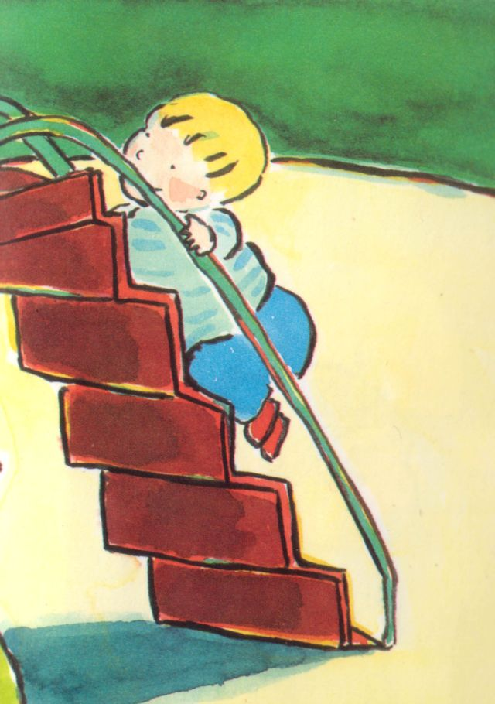
Mutual recognition requires mutual trust = built step by step

Slide 25
Thank you for your attention!!

